Slide 1
Future Cart: AI-Driven Demand Prediction for Smarter Retail
- Enhancing E-Commerce through Effective Demand Forecasting
Presented By :
Adigopula Sasi Kaladhar

Slide 2
INTRODUTION
This project focuses on creating a robust demand forecasting model tailored to the needs of an E-Commerce business. The model integrates advanced time series analysis and multivariate regression techniques, leveraging historical sales data and key performance indicators (KPIs) from platforms like Google Analytics. These KPIs, such as Google clicks and Facebook impressions, serve as vital indicators of customer interest and engagement. By combining these data sources, the project aims to provide actionable insights for smarter inventory and marketing strategies, ensuring businesses stay ahead in a competitive market.

Slide 3
PROJECT STATEMENT
1.Importance of Demand Forecasting
Demand forecasting is a cornerstone for success in E-Commerce. Accurate predictions help
businesses:
A. Optimize inventory management.
B. Reduce costs related to overstocking or understocking.
C. Improve customer satisfaction by meeting demand effectively.
2.Project Objective
The primary goal is to develop a robust demand forecasting model that:
A. Predicts future product demand.
B. Aids in strategic planning and decision-making.

Slide 4
3.Data Sources and Techniques
The model leverages multiple data streams and techniques:
A. Historical Sales Data: Provides a foundation for understanding trends and patterns.
B. Time Series Analysis: Captures seasonal and cyclical trends in demand.
C. Multivariate Regression: Incorporates multiple variables to improve prediction accuracy.
4.Incorporation of Digital KPIs
Key performance indicators (KPIs) from digital analytics enhance the model, including:
Google Clicks: Reflect customer engagement from search engines.
Facebook Impressions: Indicate brand visibility and potential customer interest.
5.Value Proposition
By integrating traditional sales data with digital marketing KPIs, the model provides:
A comprehensive view of demand drivers.
Actionable insights for inventory and marketing optimization.
Enhanced ability to predict and meet customer demand effectively.

Slide 5
EXPECTED OUTCOMES
Improved Inventory Management: Enhanced accuracy to reduce stock-outs and excess inventory. Enhanced Marketing Efficiency: Identifying demand periods for optimized resource allocation. Data-Driven Decision Making: Reliable forecasts for informed business decisions. Accurate Demand Predictions: High accuracy levels to improve customer service. Scalable Solution: Capable of managing large datasets and varying demand patterns.

Slide 6
IMPLEMENTATION PLAN
Module 1:
Data Collection - Understanding the problem statement and gathering relevant sales data.
Module 2:
EDA and Data Preprocessing - Formatting data and handling missing values.
Module 3:
Time Series Modeling - Exploring univariate models and optimizing parameters.
Module 4:
Dynamic Multivariate Regression - Incorporating lagged values to influence future sales.

Slide 7
METHODOLOGY OVERVIEW
Time Series Analysis:
Time Series Analysis for Future Cart Demand Forecasting involves using historical data to predict future demand by identifying trends, seasonality, and patterns.
Key steps include data preprocessing to handle missing values and outliers, EDA with decomposition techniques, and stationarity checks like the Augmented Dickey-Fuller test.
Forecasting models range from ARIMA and SARIMA for seasonal trends to advanced machine learning models like XGBoost and LSTM for multivariate analysis. Performance is evaluated using metrics like MAE, RMSE, and MAPE.

Slide 8
Dynamic regression :
It is a forecasting method that combines time series and regression techniques to model relationships between a dependent variable and one or more independent predictors, including lagged values.
It captures both immediate and lagged effects of predictors, making it suitable for handling time-dependent interactions Incorporating multiple predictors to improve forecasts.
Model Evaluation Metrics:
Employing MAE, RMSE, and Adjusted R-squared for performance comparisons.

Slide 9
RESULTS & INSIGHTS
1. Visualizations of Forecasts: Presentation of predicted vs. actual sales.
2. Key Takeaways: Identification of optimal marketing strategies based on demand insights.
3. Business Implications: Recommendations for resource allocation and pricing adjustments.

Slide 10
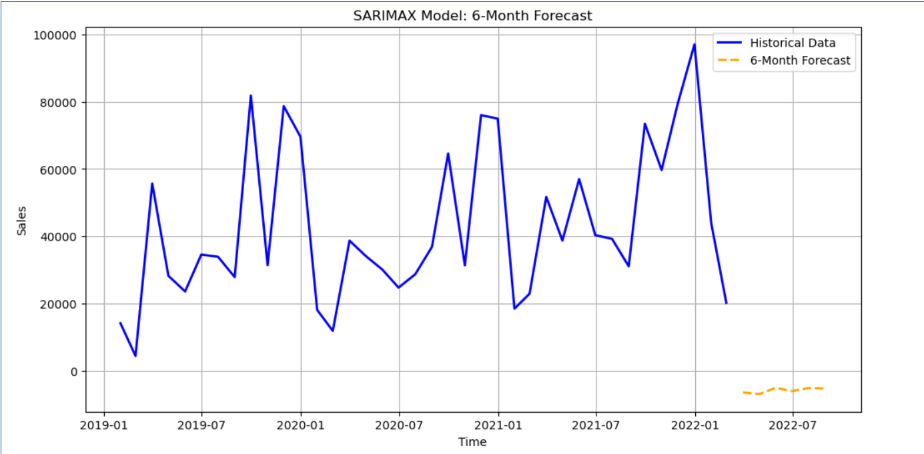

Slide 11
SARIMAX Model Forecast for demand Prediction
Key Insights:
The SARIMAX model was used to forecast the Quantity for the next 3 months based on historical data.
The green line represents the actual observed data, which shows significant fluctuations and volatility.
The red line represents the forecasted values, indicating stabilization of future demand with reduced variability.
This forecast provides insights into expected trends and can assist in:
Inventory Management: Ensuring sufficient stock levels.
Operational Planning: Preparing for stable demand.
Marketing Efficiency: Targeting campaigns to optimize sales.

Slide 12
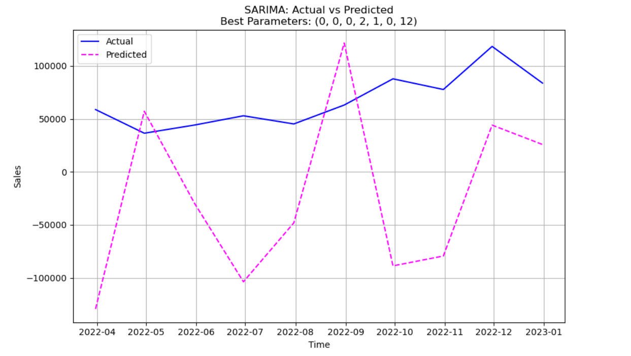

Slide 13
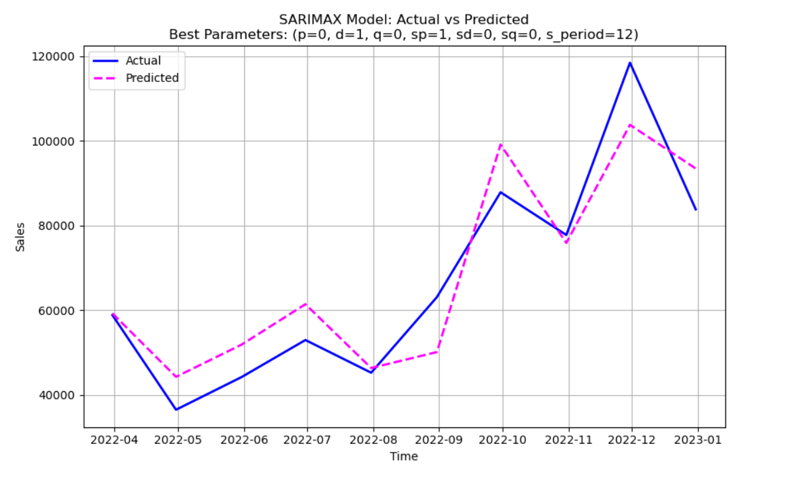
BEST MODEL

Slide 14
Best Model: Actual vs Predicted Values
This slide visualizes and compares the performance of our best model in predicting actual values.
The line chart shows the comparison between the actual values (blue line) and the predicted values (orange line) generated by our best model.
The x-axis likely represents the time period or some other independent variable, while the y-axis represents the quantity or target variable.

Slide 15
CONCLUSION
Here , by using the SARIMAX model I have forecasted the next six months data. Here in the above plot we can observe the forecasted sales plot.
The red line represents the SARIMAX model's forecast for the next three months. This projection is based on historical patterns and trends observed in the input data.
The x-axis is formatted to show calendar months, making it easy to interpret the temporal progression of both the historical data and the forecast.

Slide 16
The y-axis represents the predicted values of Quantity. The red forecast line allows stakeholders to understand expected changes or trends over the forecast period.
The forecast highlights potential growth, decline, or stability in Quantity over the next three months, enabling data-driven decision-making and planning. Any sharp increases or decreases in the forecast can signal significant shifts in underlying factors.

Slide 17


